Slide 1

Windsurf AI : Comprehensive Analysis and Comparison
Features, Compatibility, and Cost Evaluation.
Date : 08/04/2025

Slide 2
Introduction
.Introduction to AI-powered code editors enhancing developer productivity.
Focus on Windsurf AI and its position in the market.
Key features of Windsurf AI, its various versions, compatibility with different IDEs, and an overview of its performance against competitors Traycer and Curser

Slide 3

01
Windsurf AI Features

Slide 4

What is Windsurf AI?
Windsurf AI provides advanced capabilities such as machine learning integration, real-time data processing, and user-friendly interfaces.
Its AI algorithms enhance development efficiency, offering intelligent code suggestions and error detection.
Additionally, it supports collaborative features for team projects, making it suitable for both individual developers and enterprises.
An AI-powered code editor designed to integrate advanced AI functionalities directly into the development environment.

Slide 5
Features
Real-time code completions.
Context-aware suggestions.
Intuitive user interface.
Cascade feature for automatic context filling and command execution.

Slide 6
Supported Versions
Windsurf AI is available in multiple versions catering to different user needs. The standard edition is designed for individual developers, while the enterprise edition includes additional features for larger teams, such as centralized management tools and enhanced security options. Furthermore, regular updates ensure that users have access to the latest technology advancements.

Slide 7
Compatibility with IDEs
Windsurf AI is designed to be compatible with various Integrated Development Environments (IDEs) including IntelliJ, Visual Studio Code, Eclipse, and more. This compatibility allows users to seamlessly integrate Windsurf AI into their existing development workflows.
With specific plugins for each IDE, developers can take advantage of Windsurf AI's functionalities without disrupting their usual coding practices.
Seamless integration with IntelliJ IDEA, offering features like multi-line auto-completions and code generation commands.

Slide 8
Features Available for IntelliJ
Integration Highlights:
Multi-line auto-completions.
Code generation commands.
Enhanced development workflow within IntelliJ IDEA.

Slide 9

02
Windsurf AI vs Competitors

Slide 10
Comparison with Traycer
Feature | Windsurf | Traycer
Focus | Agent-based IDE | Task-oriented coding assistance
Key Features | Cascade, Supercomplete, Command Mode, Flows | Tasks
Strengths | Large codebase support, clean UI, affordable | Task management, breaking down complex tasks
Weaknesses | UI/UX may be less polished | Less focus on IDE experience
When compared to Traycer, Windsurf AI excels in its predictive coding features and ease of integration within IDEs.
Traycer offers some similar functionalities, such as performance optimization tools, but many users prefer Windsurf AI for its user-friendly interface and responsiveness.
Additionally, Windsurf AI's community support and frequent updates provide an edge in maintaining reliability.

Slide 11
Comparison with Curser
Windsurf | Cursor
Features | Context-aware suggestions, clear code, reliable implementations | Bug finder, experimental features, power features
Learning curve | Good for beginners | Steeper learning curve
Speed | Slower but more stable | Faster but may need fine-tuning
UI | Cleaner, more polished
Curser also presents a competitive alternative to Windsurf AI, featuring capabilities designed for specific programming environments. However, Windsurf AI stands out due to its versatility across multiple platforms and programming languages.
Users have noted that Windsurf AI offers better customization options and a more robust set of features compared to Curser, leading to higher productivity.

Slide 12

Pricing Comparison
Windsurf AI:
Starts at $15 per seat.​
Cursor:
Pro plan at $20 per month.​
Business plan at $40 per user per month.​
Traycer:
Free plan for open-source projects.​
Pro plan at $10 per month.​
Business plan at $20 per month.

Slide 13
Cost Analysis for Enterprises
Scenario: Enterprise with 100 developers.​
Monthly Costs:
Windsurf AI: $1,500.​
Cursor: $4,000.​
Traycer: $2,000.
Annual Costs:
Windsurf AI: $18,000.​
Cursor: $48,000.​
Traycer: $24,000.

Slide 14
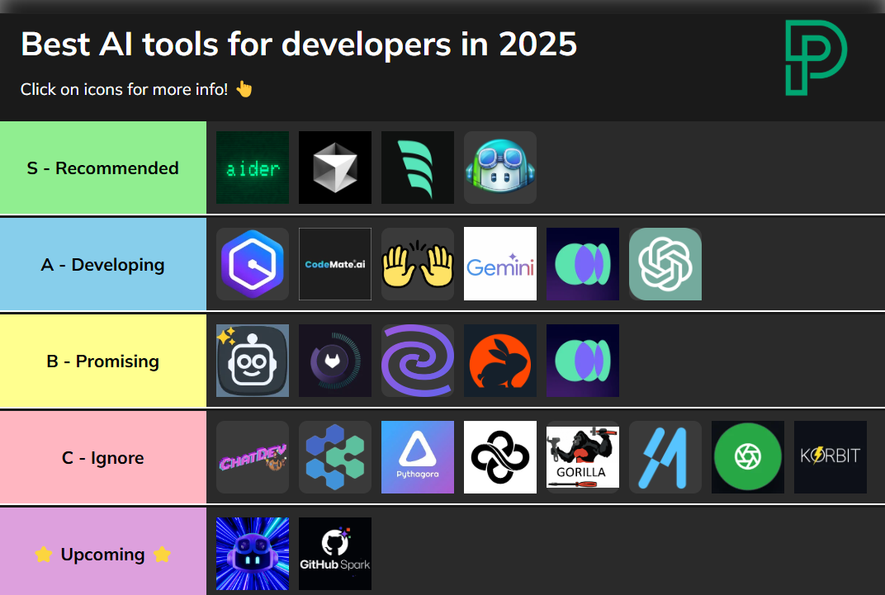
curser
windsurf
Github Copilot

Slide 15

Conclusions
In summary, Windsurf AI offers a comprehensive suite of features that enhance software development across various IDEs. Its compatibility, coupled with a strong competitive advantage against alternatives like Traycer and Curser, makes it a compelling choice for enterprises. Cost-benefit analysis suggests that investing in Windsurf AI could yield significant productivity improvements, solidifying its value proposition in the market.

Slide 16

Thank you!
Do you have any questions?
+91 620 421 838

